Slide 1
Week 02, Day 02
Typography and Responsive Design
CodeSLO 2018

Slide 2
Typography

Slide 3
Typography
In web design, typography is the use of fonts, line width, height, and spacing in order to make your content more attractive and consumable.
Typography is one of the cornerstones of web design, but we aren’t going to cover the topic in-depth in this class.
Instead, we’re going to tell you some general guidelines, and show you a good resource for finding new and specialized fonts online.

Slide 4
Elements of Typography
We’ll talk about seven elements of typography today.
Color Contrast
Font Size
Leading
Kerning
Hierarchy
Whitespace
Font Choice

Slide 5
Color Contrast
Color contrast is a good way to make your text stand out.
You want to avoid colors that are too close together. One trick you can use to determine if this is the case is to test your background and foreground color choices in Photoshop or a similar utility. Type out and example and then render the image into grayscale. If you have a hard time reading your text, the colors don’t contrast enough.

Slide 6
But not TOO much contrast
You also want to avoid too much contrast. Black on white, for example, is a bit much. If you look at most professional web pages, you’ll see they actually use gray text on a white page.
This rule doesn’t apply to black or very dark websites, which are all about high contrast.

Slide 7
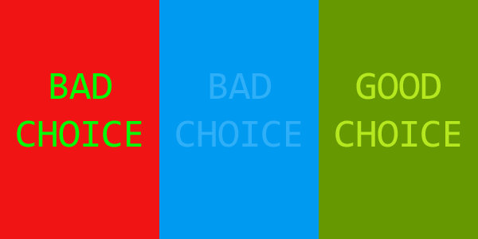
Good vs Bad Color Contrast

Slide 8
Font Size
In general, you should consider the minimum font size to be 13px for a web page. 16px is the standard. 18px looks pretty good, too.
Font size can be controlled with the CSS property font-size.
If you are building a site for an older audience, you might consider increasing the font size a bit.

Slide 9
Leading
Leading is the print term for line height, which can be controlled by the CSS property.
Generally, line height is set to a percentage of the font size, with 120% being a good guideline.
You can use this rule in CSS like this:
line-height:1.2;

Slide 10
Kerning
Kerning is the spacing between letters. It usually comes into play in large heading elements.
In CSS, kerning can be controlled with the letter-spacing command. Letter spacing can be given in pixels and even sub-pixel sizes such as .8px or 1.2px.
letter-spacing:1.2px;

Slide 11
Hierarchy
Hierarchy is using font size, font color, and other techniques to draw attention to certain areas of content.
One easy tool web designers have for establishing hierarchy is the various sizes of text available through heading a paragraph tags in HTML.
It’s possible to get a lot more creative than that, however.

Slide 12
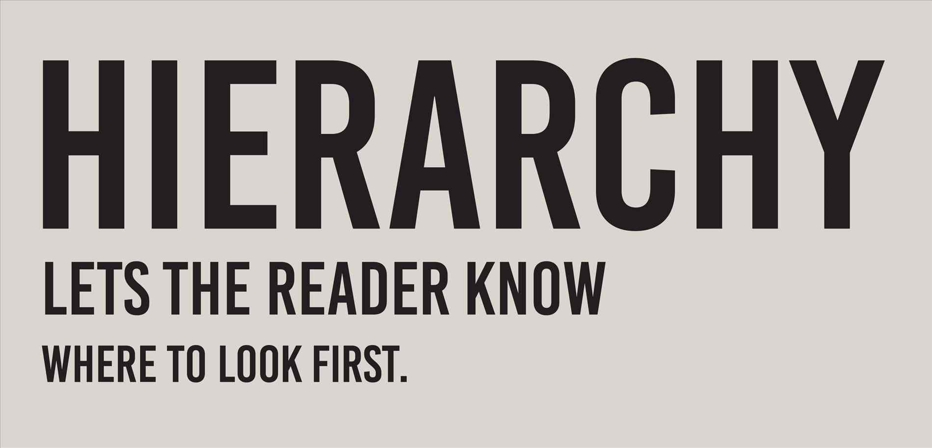

Slide 13
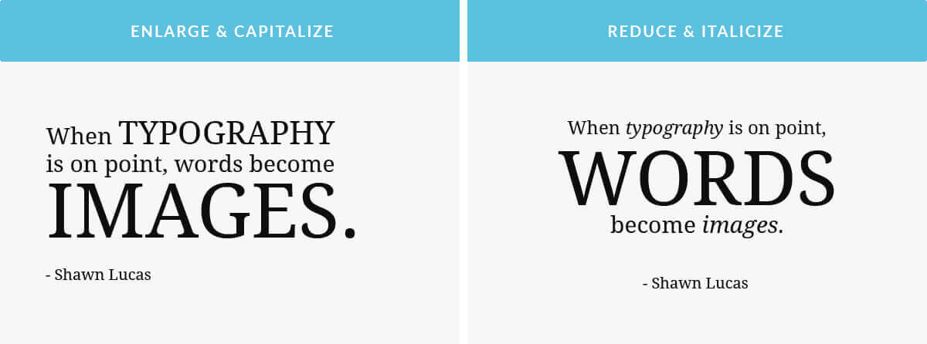

Slide 14
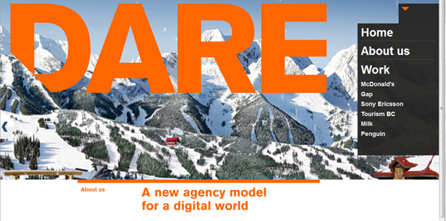

Slide 15
Time to check in!

Slide 16
Whitespace
Whitespace is a good design principle in general, not just for typography.
Too little whitespace can make your content feel like clutter.

Slide 17
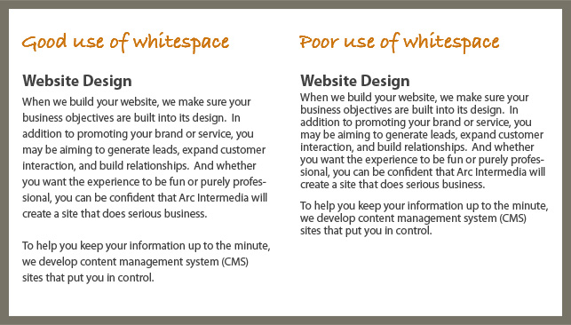

Slide 18
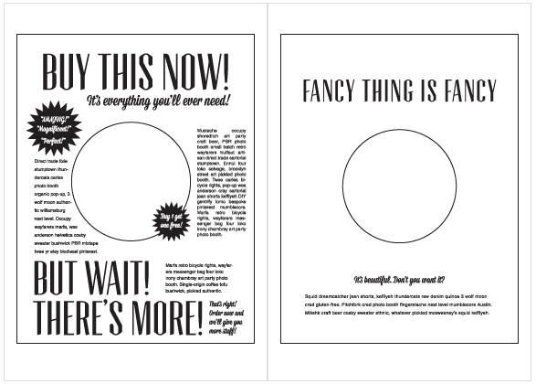

Slide 19
Font Choice
Fonts can help you create a certain feel on your web pages. They can be elegant, artistic, casual, friendly, fun, or silly. Make sure you create the impression you want!
There are two basic font families, serif and sans-serif. It is generally thought that sans-serif fonts are easier to read online.
You should avoid using too many fonts on a page. Usually one or two is plenty, and three should be an absolute maximum.
Fonts can be changed in CSS with the font-family property.

Slide 20
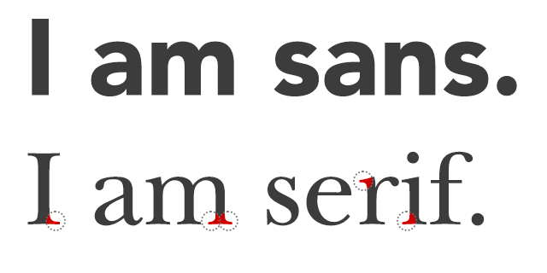

Slide 21
Google Fonts
Google Fonts is an excellent, free source for all kinds of new fonts to really make your webpages pop. It’s easy to use and has perhaps too many choices.
A good idea when getting started with typography is to Google for attractive fonts and font pairs. This can give you some inspiration for your pages. Later, you can come up with your own pairings.

Slide 22
How to use Google Fonts
Google Fonts are brought in much like external stylesheets.
You then set which fonts go to which elements with CSS.
Look at the google-fonts.html example in today’s source code to see how its done.
Also, see our typography-example.html and typography-dark.html.
Check out this quick demo of how to select fonts on the Google Fonts site.

Slide 23
Exercise: Eye-Catching Article
Create a new file called typography.html
Give your new page a doctype declaration, head and body sections
Create an external stylesheet for your page called type-style.css and link to this sheet in your page
Go to Google Fonts and select two fonts for your new article. Use one for headings and another for content (hint: search for good font pairs available on Google Fonts)
Use font size, color, line height, width, and centering to create an attractive-looking article. See typography-example.html for inspiration.

Slide 24
Take a break
Back in Five...

Slide 25
Responsive Design

Slide 26
The origins of responsive design
In the wonderful Garden of Eden that was the web prior to 2007, websites were often designed statically. That is, they were a fixed number of pixels wide and sites could basically be designed in something like Photoshop and then converted to HTML.
The invention of the iPhone burned that garden to the ground. These days, we have to design our sites to look good on everything from 4-inch smart phone screens to 72” web-enabled HDTV sets.

Slide 27
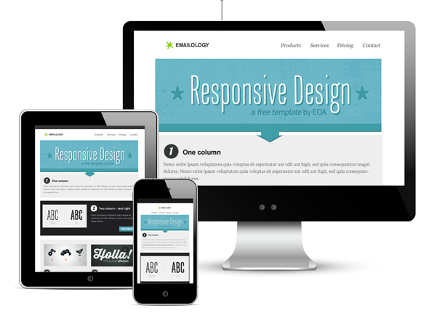

Slide 28
Responsive Design with Chrome Dev Tools
Let’s take a peek at our typography-example.html file. It looks pretty good on a monitor.
Now use the Chrome Developer Tools to look at it as it would appear on a Galaxy S5 Smartphone.
Watch our quick demo to see how this is done.
** You can also use typography-dark.html as an example if you’re feeling edgy.

Slide 29
Problems in smartphone land
So obviously, that’s not a great experience for a smart phone user. Our CSS rules are wrecking the party.
If only there were a way to create a different set of CSS rules that were only applied if the user was on a smaller device.
Oh wait, there is. It’s the CSS Media Query.

Slide 30
Example of a media query
@media(max-width: 750px){
body{
width:95%;
}
}

Slide 31
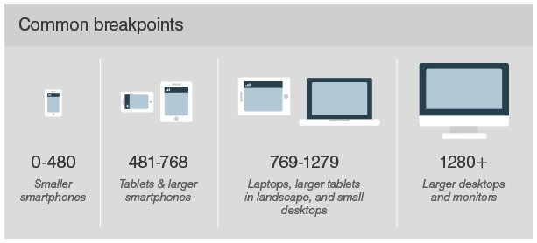
Breakpoints

Slide 32
A Chrome Dev Tools Gotcha
The device emulator for Chrome Dev Tools is pretty good, but it does require you to put one extra line of code in your HTML. This is due to how it renders its emulated pages. You can see an example of using this code in typography-responsive.html
<meta name="viewport" content="width=device-width">

Slide 33
Let’s look at an example
Let’s take a look at typography-responsive.html and typography-responsive.css to see how media-queries work.

Slide 34
Exercise: Fix your eye-catching article
Using a CSS media query, create new rules for your article when viewed on a screen smaller than 769px. IE, anything smaller than a desktop device.
Test in Chrome Dev Tools to make sure your site is attractive and consumable on mobile devices
In a real project, it is possible to use many separate media queries to account for different breakpoints.

Slide 35
Display: Inline-Block
There are other tricks we can use beyond just media queries.
We’ve discussed the difference between block-level and inline elements, but with CSS we don’t have to accept these as absolute differences. In fact, we can change them at will.
Let’s use use the Display property to turn a simple list into a grid
Using this technique to create ‘grids’ of images is one way to make our pages more responsive.

Slide 36
HTML Unordered List
First, obviously, we’ll need to make a list.
HTML lists come in two flavors: ordered and unordered
Ordered lists are numbered. Unordered lists are marked with bullet points, which can be hidden with CSS.

Slide 37
<ul>
<li>This is a list item</li>
<li>This is another list item</li>
<li>Yet another list item</li>
</ul>

Slide 38
Exercise: Kitten List
Create a new page called kitten-list.html
Give your page a head, body, and doctype declaration
Give your page an internal stylesheet
Add an unordered list with six items to your new page. The text for each item should be kitten-01, kitten-02, etc.
Save and test your new page

Slide 39
Exercise: Kitten-List (cont)
Now we’re going to change your list into a list of images
In today’s code you’ll find a folder called kittenpics that contains images of five adorable kittens and one angry one.
Replace the text in your <li> elements with <img> elements, one for each kitty
Save and test your page

Slide 40
Demo: VS Code Multi-Cursor
Check out this super-cool ultra-ninja way to create a list of images with a lot less typing using VS Code’s multi-cursor feature

Slide 41
Exercise: Kitten-list (cont)
Give your <ul> element a class of kitten-gallery
In your stylesheet, create a rule for kitten-gallery
Select all the <li> elements in kitten-gallery by making a rule for .kitten-gallery li
Give the <li> elements a declaration for display: inline-block
Save and test!

Slide 42
About Display: inline-block
Inline-block gives a lot of the benefits of both block and inline elements. Display can also be used to declare inline or block properties.
Inline-block is very useful for making responsive grids.
Try to resize your browser window and watch how kitten-list responds

Slide 43
Exercise: Kitten-List (cont)
Let’s polish our gallery a little bit by adding a few more CSS declarations
.kitten-gallery li{
display:inline-block;
border:2px solid orange;
padding:10px;
text-align:center;
font-weight:bold;
}

Slide 44
Exercise: Kitten-list (cont)
Let’s add captions to our pictures by adding a <p> element to each <li>
<li><img src="kittenpics/kitten-01.jpg" /><p>Loves to be pet</p></li>
<li><img src="kittenpics/kitten-02.jpg" /><p>So cuddly</p></li>
<li><img src="kittenpics/kitten-03.jpg" /><p>Curious kitty</p></li>
<li><img src="kittenpics/kitten-04.jpg" /><p>A cottonball that purrs</p></li>
<li><img src="kittenpics/kitten-05.jpg" /><p>Beware: Very dangerous</p></li>
<li><img src="kittenpics/kitten-06.jpg" /><p>Happiest kitty on Earth</p></li>

Slide 45
Exercise: How to Google With Style
Now it’s time to make your How to Google page a work of digital art.
Use everything you’ve got. Typography, positioning, divs, classes, and responsive design.
You should end up with a site that looks great on any device.

Slide 46
Questions?

Slide 47
More about web and UX design
Web and UX Design are very deep topics, and we’ve only scratched the surface over the last few classes.
If you want to learn more about design, try the full curriculum at Hack Design.
https://hackdesign.org/lessons

Slide 48

Coming Up
Tomorrow we start our deep dive into JavaScript. You’re going to learn kung-fu.

Slide 49
Code on!

